Slide 1
PROCESS REDESIGN
METHODOLOGY
by
Mustafa Shiraz Ahmed
LECTURE 4

Slide 2
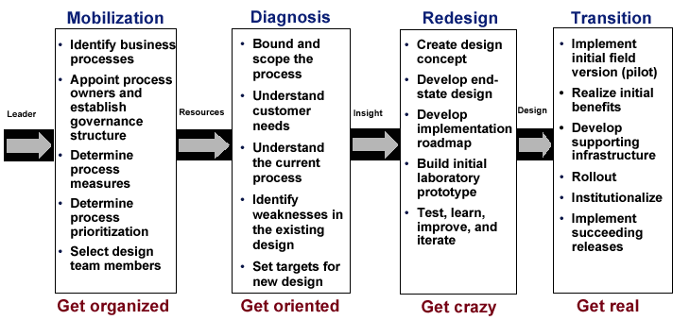
A Process for
Process Redesign

Slide 3
Where Redesign Goes Wrong
Insufficient mobilization
  ineffective process identification or inadequate resources
Ineffective study of existing processes
  too detailed and/ or too narrow
Vagueness in objectives
  failure to specify goals
Timidity in redesign
  narrow scope, small goals, self- censorship
Skipping the laboratory
  reengineers are real engineers
Taking too long
  time is our enemy

Slide 4
The Three Challenges of
Process Redesign
Innovation
  inventing something new
Complexity
  building a new system
Change
  reinventing the business

Slide 5
The Three Keys to Success
Creativity
  in design
Coordination
  in implementation
Change management
  throughout

Slide 6
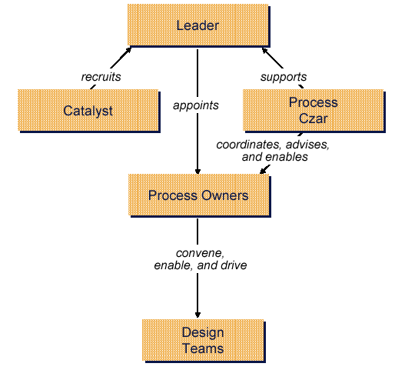
A Structure for
Process Design

Slide 7
The Process
Owner
A senior individual with accountability and authority for the end- to- end performance of a process
  a never- ending responsibility
  aka process manager, process leader

Slide 8
The Process
Owner
Duties
  sponsor, motivator, evangelist, salesperson, resource obtainer, enabler, goal setter
  monitor, advisor, groupthink avoider
  liaison, buffer, roadblock remover, heat taker, advocate
  convener, coach, champion, conscience, challenger, cheerleader, critic, customer
  controller and compliance officer

Slide 9
The Process
Owner
Requisites
  highly placed, well respected, well connected
  ambitious, confident, high energy, effective
  innovative and process- oriented, often a maverick
  really gets it
  the right person in the right position

Slide 10
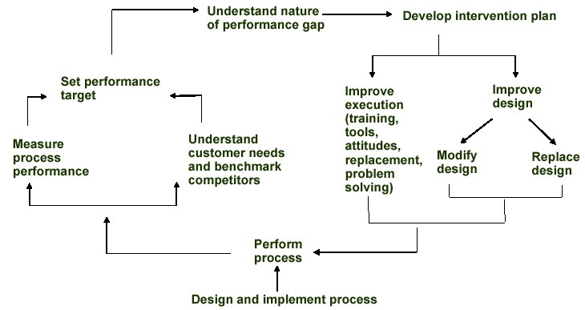
The Process
Lifecycle

Slide 11
The Process
Design Team
Insiders
  knowledge of business and customers
  intuition and experience
  credibility and opinion leadership
  moderate seniority

Slide 12
The Process
Design Team
Outsiders
  reengineering technique
  imagination, creativity, naiveté
  objectivity, risk- taking, and leavening
  ability to maintain distance

Slide 13
The Process
Design Team
Composition
  diagonal slice
  multiple functions and constituencies represented
  concentric rings: core team and extended team
  occasional involvement of specialized disciplines
  participation of customers and suppliers in extended team

Slide 14
The Process
Design Team
Team captain
  manager of a key stakeholder function
  facilitator, politician, diplomat, quartermaster

Slide 15
The Process
Design Team
Rules of engagement
  primary assignment ( preferably 100% ) : the problems of logistics, contamination, schizophrenia, emergencies, and
  hypocrisy
  long- term commitment ( 18- 24 months)
  abandoning organizational loyalties
  cohabitation: the communication vs. distance curve

Slide 16
The Process
Design Team
Challenges
  finding the resources: coping with a full plate
  managing a cross- cultural ensemble
  team- building ( may be deliberate)
  dealing with conflict
  relationship with the owner: customer, coach
  life after design: for insiders, outsiders, and process owners

Slide 17
The Process
Design Team
Enthusiasm, optimism, and ambition
Persistence, energy, tenacity, self- esteem, stamina, thick skin, follow- through, resilience, commitment, courage
Process thinking: systems, big picture, holistic, critical, quick learner
Design capability: open mind, creativity, evaluation of tradeoffs, performance analysis, trouble- shooting, problem-solving, resourcefulness

Slide 18
The Process
Design Team
Questioning, skepticism, open mind, unafraid
Comfort with rule breaking, ambiguity, change, and risk
Broad business perspective
Inter- personal, teamwork, listening, persuasion, and communication skills

Slide 19
Challenges in
Recruiting the Team
Finding them
  5% - 20% are candidates
Getting them to join
  lowering disincentives
  addressing career concerns
  the value of financial incentives
  personal recruiting by the leader

Slide 20
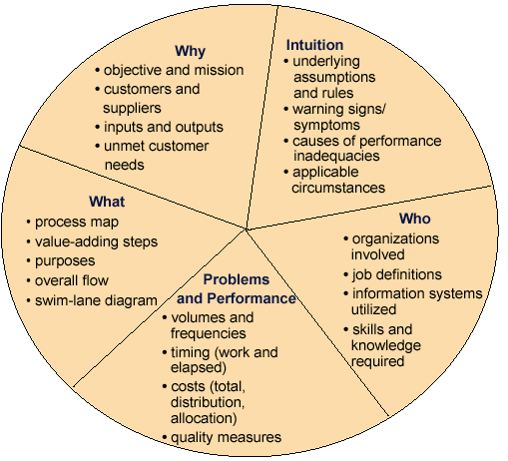
The Product of a
Process Diagnosis

Slide 21
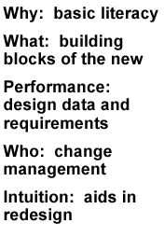
The Product of a
Process Diagnosis

Slide 22
Do The Right Designing
Don ’t take a long time
  this is only the preamble
Don ’t get bogged down in detail
  focus on the big picture: what and why, not how
Don ’t get lost in complexity
  focus on the base case first, deal with exceptions laterx

Slide 23
Simplification and Rationalization
Don ’t produce lengthy outputs
  ten pages, not hundreds
Don ’t get hung up on tools
  a second- order issue
Don ’t do it in a conference room
  “staple yourself to an order ”

Slide 24
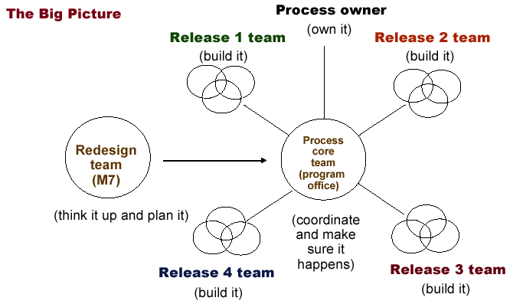
The Overall Snap

